Slide 1
Strategic Planning Committee 2017 Year End Update
Review of new strategic actions and initiatives

Slide 2
Who Are We?
Name | Documented Position
Samuel Ellis | Finance representative, appointed by Dean of Finance
Cathleen Ferrick | Faculty representative
Dr. Nicholas Gill (Chair) | Associate Dean of Institutional Research and Planning
Melinda Gilliam | Student representative
Audrey Gup-Mathews | Academic Affairs representative, appointed by VP/Academic Dean
Paul Gurney | Appointed note taker
John Hall | Staff-selected representative
Brittany Heaward | Student Affairs representative, appointed by Dean of Students
Peg Wheeler | Faculty representative

Slide 3
What We Had from 2015-16
Mission Statement
Vision
Core Values
Goals
No Actions or Initiatives (flesh out goals)

Slide 4
YCCC’s Strategic Goals (2016)
Pursue educational excellence by promoting and measuring student success in all forms.
Enhance collaboration and strengthen connections to meet community needs.
Maintain and advance our technological and physical infrastructures to meet the needs of the college community.
Continually assess and improve accountability and resource stewardship focused on efficiency and effectiveness.
Foster innovation by investing in and empowering our employees.

Slide 5
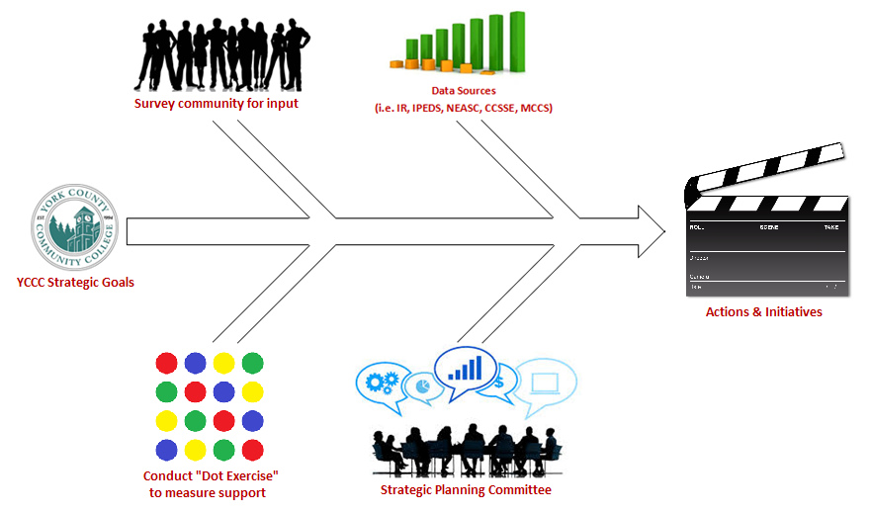
So What Did We Do?

Slide 6
Pursue educational excellence by promoting and measuring student success in all forms.
Develop course schedules that allow students to meet their educational goals, including graduation, transfer, employment, or enrichment.
Examine student feedback and review course success rates to assess academic effectiveness and format preferences (i.e. classroom, online, hybrid).
Increase course sequence planning and program tracks to ensure that pathways to student success are maximized within the confines of YCCC’s resources.
Expand on efforts to promote student literacy and numeracy such as increasing student outreach resources and assessing placement practices.

Slide 7
Enhance collaboration and strengthen connections to meet community needs.
Explore options for assisting students with childcare obstacles, such as partnerships with regional childcare facilities or an on-site service that could integrate credit programming.
Promote and offer more wellness and physical activities.
Promote business and community outreach to respond to emerging employment deficits and needs.
Expand counseling and wellness services to provide support groups, targeted wellness activities, and outreach for non-traditional students.

Slide 8
Maintain and advance our technological and physical infrastructures to meet the needs of the college community.
Establish a capital improvements budget to support the regular maintenance, repair, and updating of all physical plant, starting with the 2017-2018 annual budget
Enhance the Information Technology (IT) budget to support more regular maintenance and upgrading of the College’s technological infrastructure, starting with the 2017-2018 annual budget.
Prioritize funding for additional professional staff with skills set specifically aimed at supporting the operations of the physical plant, technological infrastructure, and database management.
Develop an integrated community feedback system for communicating areas of need and increased support with the Information Technology and Facilities staff and leadership.

Slide 9
Continually assess and improve accountability and resource stewardship focused on efficiency and effectiveness.
Explore procedural and technological options to allow students more flexibility in how they acquire their textbooks, vouchers, and other qualified academic resources.
Conduct regular process and initiative assessments at the College to evaluate the effectiveness of intra-institutional operations, services, and administration.
Prioritize professional staff funding to support a full-time administrator in the Counseling and Wellness Office.
Establish an internal resource network that would allow for cross-institutional support amongst administrative and instructional departments.

Slide 10
Foster innovation by investing in and empowering our employees.
Centralize professional development funding to allow staff and faculty equal access to attending training sessions within their fields.
Offer more regular, free, onsite, professional development opportunities for all staff & faculty.
Establish an internal knowledge network that would allow for the sharing of knowledge through peer presentations and/or a blog.
Create a conduit that allows YCCC employees to utilize grants to fund professional development opportunities and assist with application processes.

Slide 11
Questions

