Slide 1
Strategic Planning Committee
Review of New Strategic Goals and formative community and committee input

Slide 2
Who Are We?
Name | Documented Position
Angela Nadeau | Academic Affairs representative, appointed by the Vice President/Dean of Academic Affairs
Dana Petersen | Finance representative, appointed by the Dean of Finance
Brittany Heaward | Student Affairs representative, appointed by the Dean of Students
Nicholas Gill (Chair) | Associate Dean of Institutional Research and Planning
Tami Gower | Faculty Representative
Maria Niswonger | Faculty Representative
Audrey Gup-Mathews | Staff-selected Representative
Jason Goldstein | Appointed Note Taker

Slide 3
What We Had from Council
Mission Statement
Vision
Core Values
No Strategic Goals (We had 8 Directions & Actions)

Slide 4
YCCC’s Strategic Direction & Actions
Pursue educational excellence
Promote student success and engagement
Promote enrollment growth and access
Expand career and workforce development programs
Ensure resource stewardship and financial stability
Develop appropriate technology to support growth
Develop campus physical environment to support growth
Promote community outreach

Slide 5
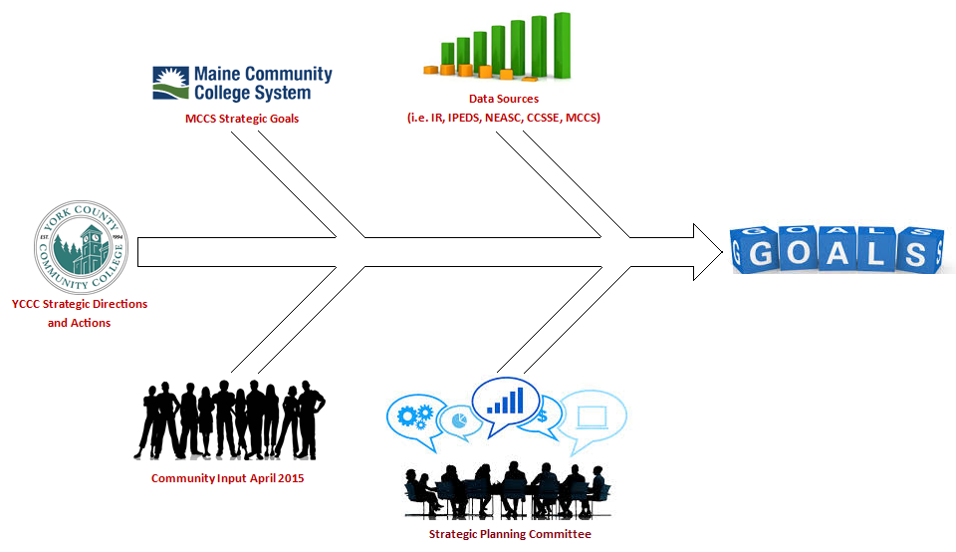
So What Did We Do?

Slide 6
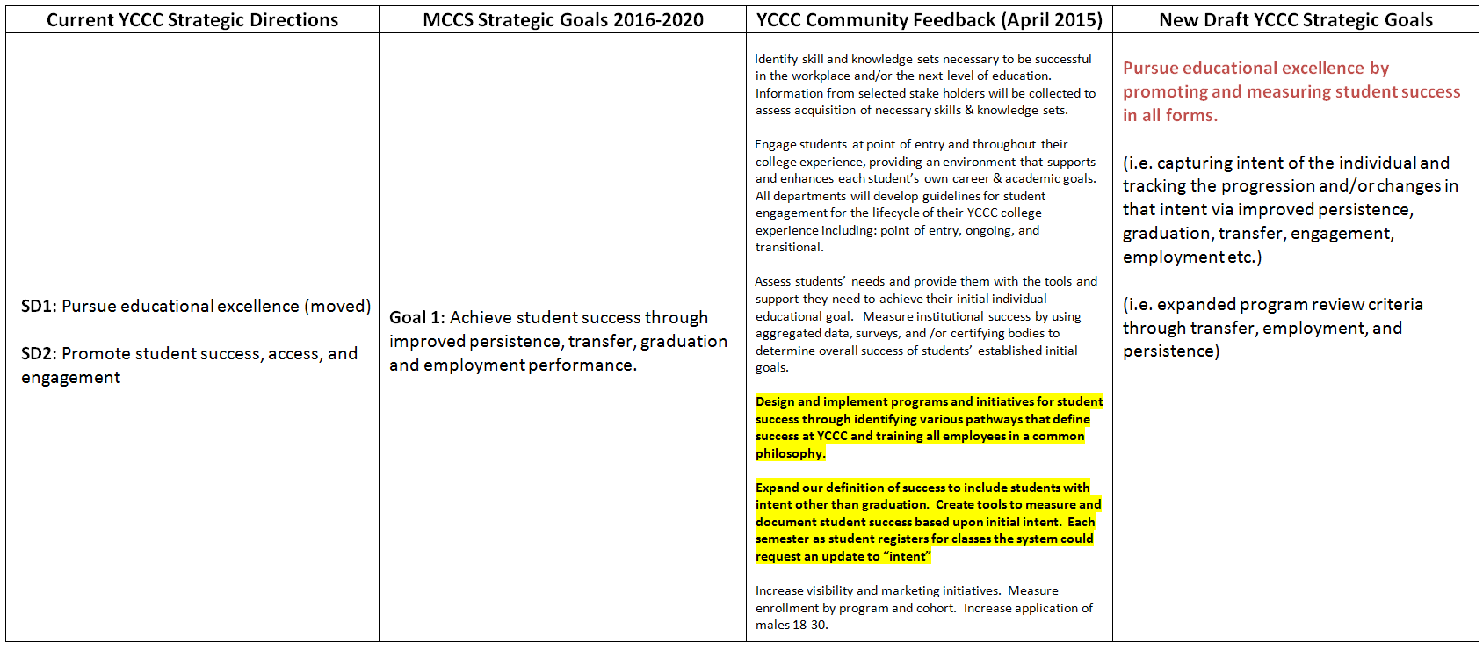
Goal 1 Pursue educational excellence by promoting and measuring student success in all forms

Slide 7
Goal 2 Enhance collaboration and strengthen connections to meet community needs
Goal 3
Maintain and advance our technological and physical infrastructures to meet the needs of the college community

Slide 8
Goal 4 Continually assess and improve accountability and resource stewardship focused on efficiency and effectiveness
Goal 5
Foster innovation by investing in and empowering our employees

Slide 9
Questions

