Slide 1
Institutional Learning Outcomes Assessment
York County Community College

Slide 2
The Committee
The Assessment Committee is a cross-departmental group made up of representatives from the faculty and staff. During the 2016-2017 academic year the group consisted of: Claudette Dupee – Retention Director, Student Affairs Annette Tanguay – Librarian Rita Perron – Adjunct faculty, Science Dianne Fallon – Faculty, English Lisa Murphy – Faculty, Social Sciences Cathleen Ferrick – Faculty, Behavioral Health Paula Gagnon – Academic Dean

Slide 3
What We Are Assessing
YCCC has developed Institutional Learning Outcomes (ILOs) which reflect our shared educational values. Each degree program has specific learning outcomes as well, which incorporate the ILOs. Because these outcomes are embedded in YCCC programs our graduates should have acquired knowledge in all ILO areas.

Slide 4
What We Are Assessing (cont.)
Institutional Learning Outcome areas are:
1. Communication
2. Quantitative Competence
3. Global Awareness, Diversity and Tolerance
4. Critical Thinking and Problem-Solving
5. Information Literacy
6. Technological Competence
7. Responsibility and Integrity

Slide 5
Process
Develop a rubric template.
Create rubrics for each individual ILO.
Gather sample papers & remove all identifying information from papers.
Complete norming exercise.
Read papers and score using rubrics.
Sort rubrics and assign a third reader for outliers.
Compile data
Close the loop by providing results to faculty which identify strengths and areas that need improvement.

Slide 6
Rubric Development
In 2014-2015, Committee begins developing and testing rubrics for all ILOs
Committee prioritized ILOs which were related to either faculty identified areas of concern or potential changes in curriculum. Over time all seven ILOs will be assessed.
Communication selected as first rubric for development.
Pilot study conducted with Communication rubric in Spring 2015

Slide 7
Doing Assessment: 1st time (2014-15)
25 papers collected from seven 200-level courses across the curriculum (English, Science, Psychology, Health Information Management)
Main finding: Improve learning in Sources and Evidence, as students struggle with integrating source material and with finding & using high quality sources.
Closing the loop: Share findings and focus on paraphrasing and integrating sources at Faculty Development Day

Slide 8
Next steps: 2015-16
In 2015-16, Committee fine-tuned Communication rubric & developed rubrics for Information Literacy and Quantitative Analysis
In spring 2016, 37 papers collected from eight 200-level online classes.
Developed goal to assess three ILOs in 2016-17, using collected samples.
Instructors teaching 200 level courses during the Spring 2016 semester were asked to provide papers related to a research-oriented assignment (i.e. used sources and citations).
Submissions received from business, education, humanities, English & social sciences.

Slide 9
Institutional Learning Outcomes Defined
Communication – Communicate effectively in a clear, well-organized manner to convey ideas with an intended audience in a variety of academic and professional settings.
Quantitative Competence –Identify , analyze and solve problems that are quantitative in nature.
Information Literacy – Apply research skills to retrieve and evaluate information and to use it ethically.

Slide 10
Data analysis
Instructors teaching 200 level courses during the Spring 2016 semester were asked to provide papers related to an assignment that was research oriented (ie. used sources and citations).
Instructors who were willing to participate in this project chose 2-5 random papers to submit.
Thirty seven papers were collected from a range of disciplines including: business, education, humanities, English and social sciences.

Slide 11
Lessons learned
One set of artifacts can be utilized to assess several learning outcomes.
(BUT): Quantitative analysis challenging to the assess without the “right” assignment. Need to gather samples that specifically address this rubric.
Norming is a useful process to start a conversation, but not a scientific method of reaching consensus.
In the end, this remains a somewhat subjective process (e.g. sources & evidence)

Slide 12
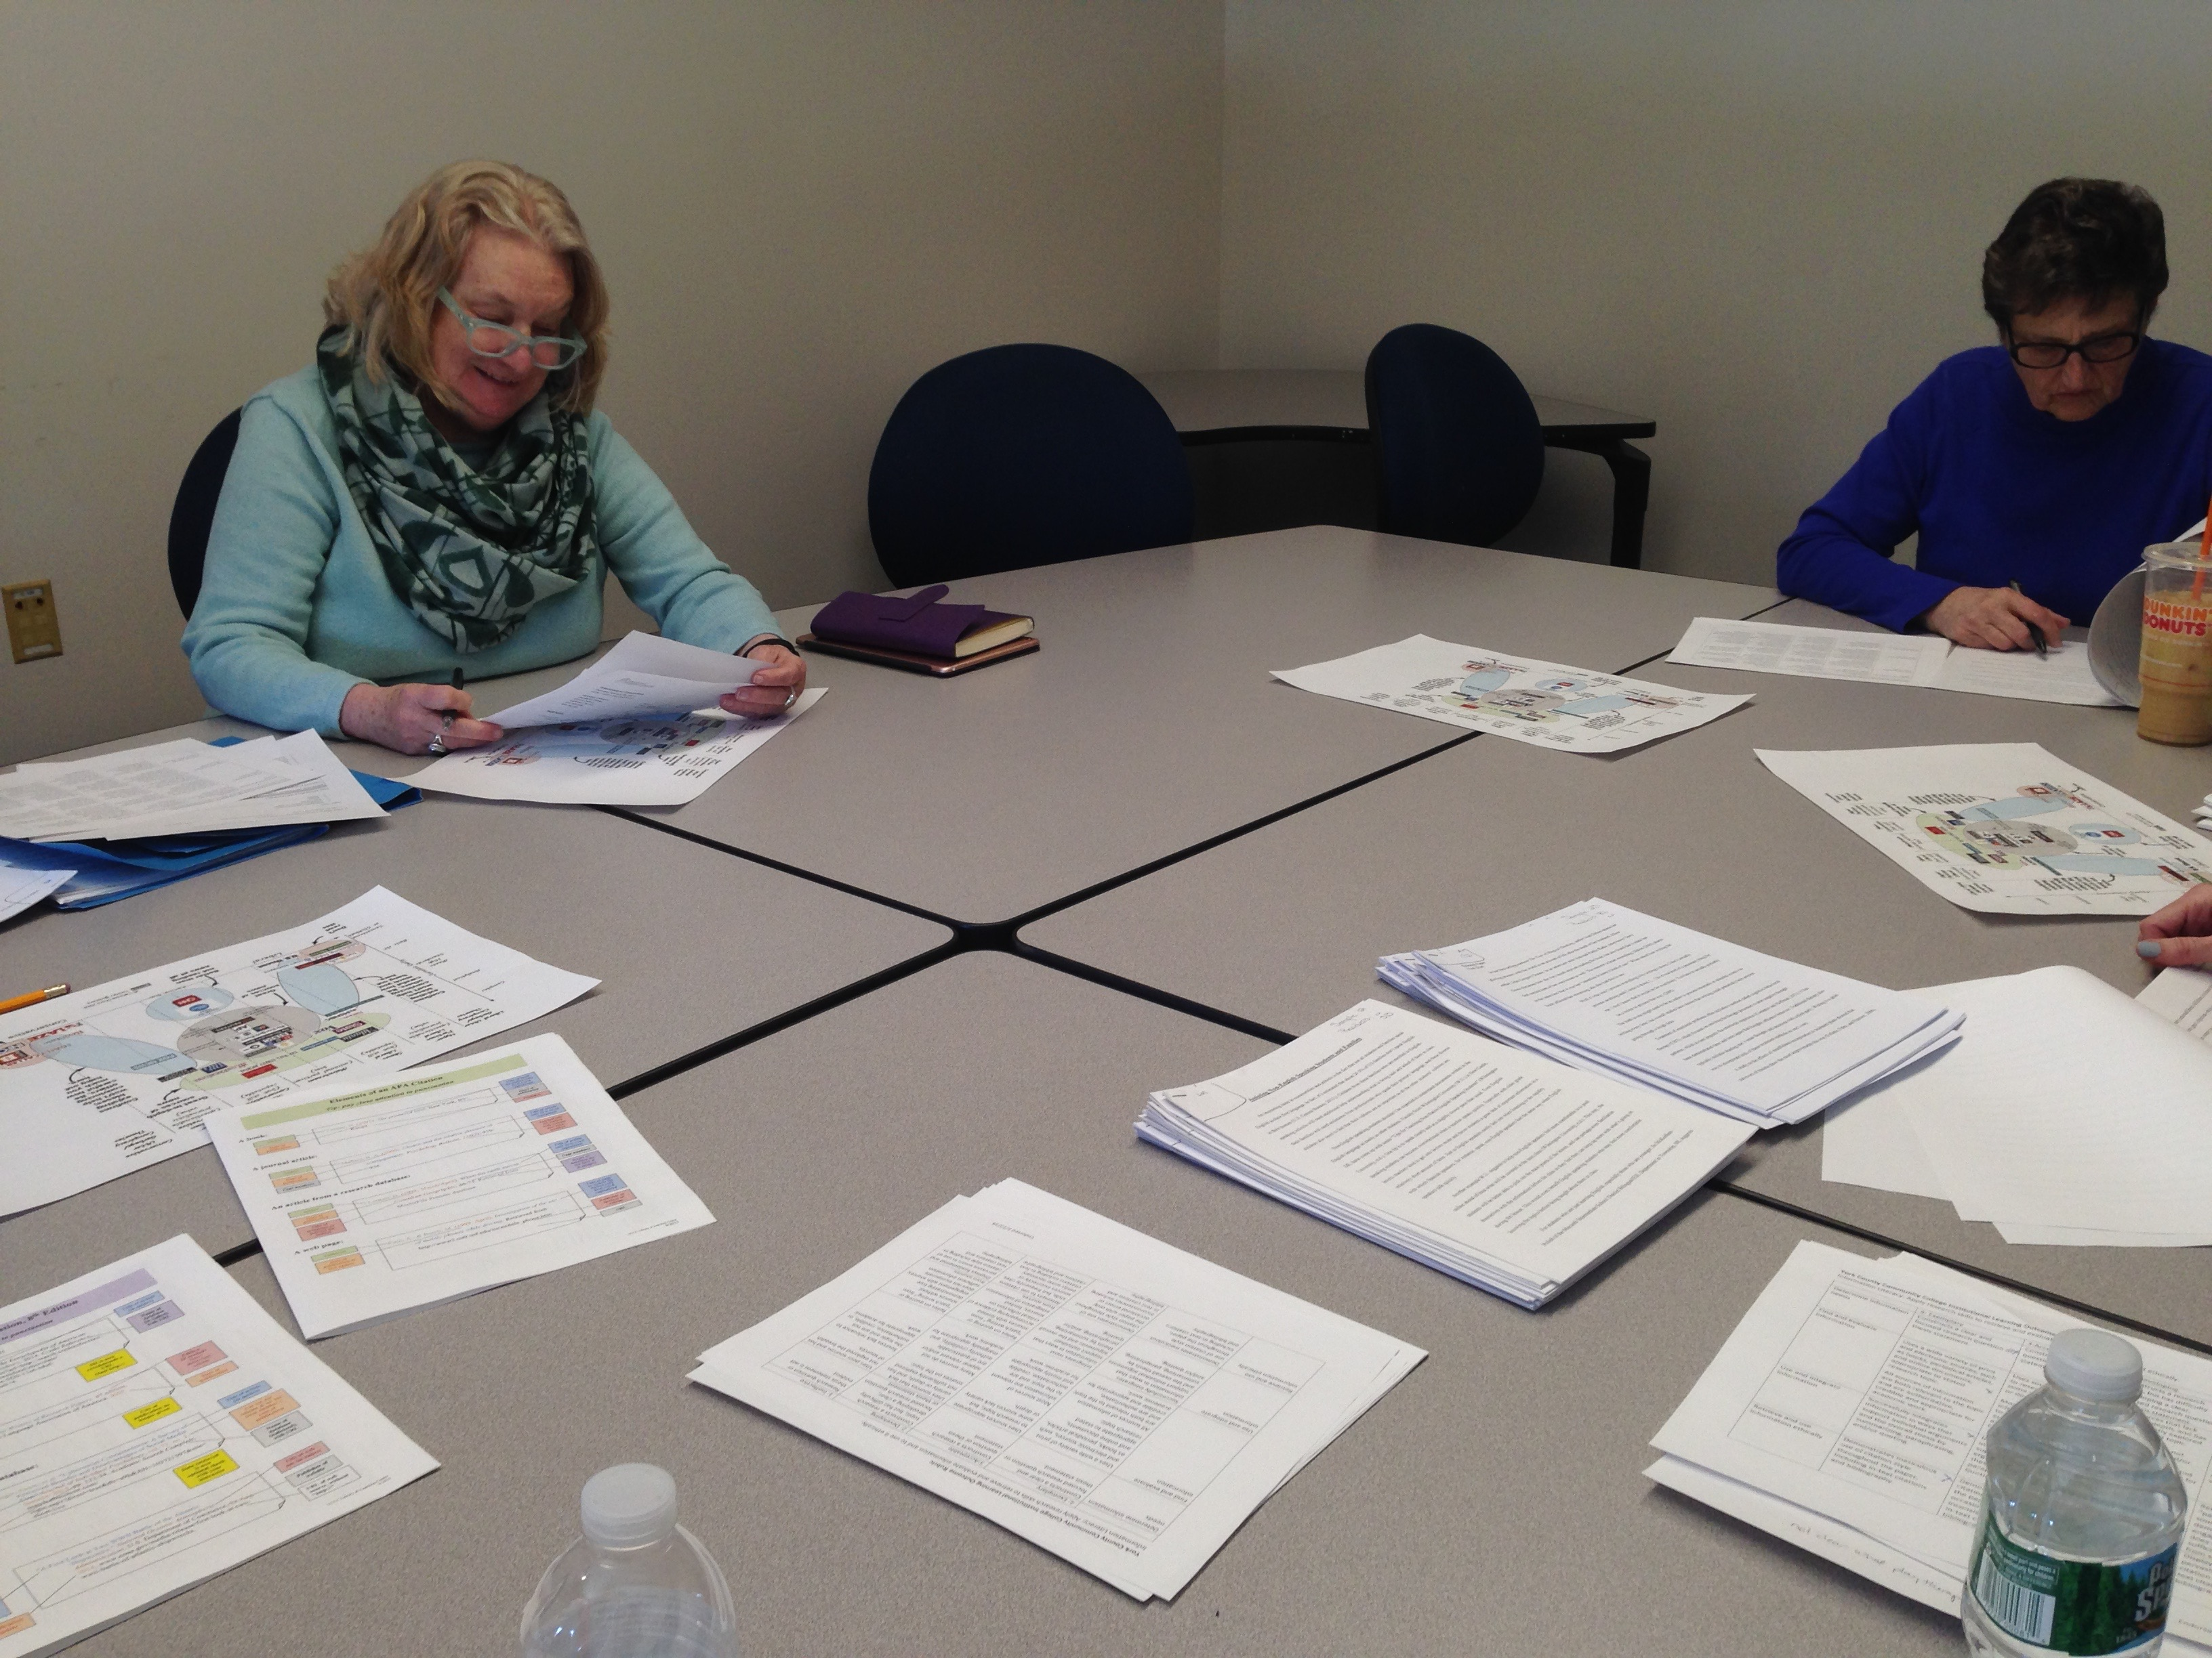

Slide 13
Data analysis
Two sets of data:
1. Rubric category scores: the aggregate total of all rubric areas scored by committee members.
2. Rubric averages for each paper: the “average” total rubric score for each artifact (student paper).

Slide 14
So how did they do?
Communication rubrics scored per paper
Exemplary scores (15-16): 3% (1 paper)
Acceptable scores (12-14): 31% (11 papers)
Developing Scores (8-11) 66% (23 papers)
Ineffective (4-7) 0%
The mode score: 10+
What do these paper scores show? Next up, rubric aggregate scores…

Slide 16
So how did they do?
Information Literacy rubrics scored per paper
Exemplary (15-16): 3% (1 paper)
Acceptable scores (12-14): 23% (8 papers)
Developing scores (8-11): 63% (22 papers)
Ineffective (4-7): 11% (4 papers)
The mode score: 11+
What? Only 26% of students have acceptable info literacy skills???

Slide 18
Student learning: How does it add up?
Online students are no different from campus students in their overall performance.
Sources and evidence continue to challenge students even in 200-level courses, especially with citation and documentation.
They can usually FIND good sources, but struggle with organizing thoughts and information in research writing.
Professionalism, including grammar & mechanics, is pretty good.

Slide 19
Closing the loop
Present findings at Faculty Development Day
Brainstorm session for practices that support student learning in targeted areas.
Involve faculty in discussions about next steps.
Encourage faculty to use tools like rubrics, templates, & Noodlebib along with library support services & instruction sessions

Slide 20
Invitation: Open the Loop!
Review communication rubric
Read sample paper
Score paper using rubric
Aggregate group score for paper by show of hands.
Discuss!

Slide 21
Ongoing Challenges
Involving more faculty in the Assessment Committee
Getting more faculty and staff to understand what assessment is and what it isn’t.
Focusing on the global and not the individual, but recognizing that we can’t improve outcomes unless individuals take the initiative to try new practices and methods.

Slide 22
YCCC Assessment Committee:
https://my.yccc.edu/ICS/Campus_Services/Governance/Assessment_Committee.jnz

